Slide 1
CHAPTER 3 SYSTEM ANALYSIS AND DESIGN FOR NAIROBI SMART PARKING SYSTEM
JOB MOGIRE
SCT222-0163/2021

Slide 2
INTRODUCTION
This chapter provides a comprehensive overview of the system design and architecture of the Smart Parking System. It details the fundamental components, technologies, and methodologies used to ensure scalability, reliability, and efficiency.

Slide 3
METHODOLOGY
The systems development methodology I chose for this smart parking system research is Agile Methodology
Reasons as to why I chose Agile Methodology
Flexibility and Adoptability- allows for adjustments
Continuous Testing and Validation- opportunity to test the system and validate it more regularly during presentation
User-Centric Development- prioritizes user input and feedback
Quick Response to changes- allows quick response to feedback

Slide 4
FEASIBILITY STUDY
The feasibility study for the smart parking system evaluates the economic, technical, operational, and other critical aspects to determine the viability of the project.
Economical Feasibility
This feasibility focuses on the financial implications of Nairobi smart parking system and whether its benefits justify its investment cost. Thus cost analysis, cost benefit analysis and Revenue analysis.
Technical feasibility
This feasibility assesses the availability of the required technology to develop the system. Thus availability of IoT tech, cloud services and scalability.
Operational feasibility
This feasibility determines how well the system will integrate to the daily parking operations. Thus ease of use, user and stakeholder support and integration with the existing infrastructure.

Slide 5
DATA GATHERING AND ANAYSIS
I used two data collections methods that is:
Observation
Observation check list
Parking conditions
Availability of online online reservation? No
Is the parking system digitized? Yes but not most of it
Parking system efficiency
Do people prefer cashless or cash payment process? Cashless
Is there a proper signage for direction? No
Is there a proper slot availability update? No
Usability of the current system
Is the current system easy to use? No
Does the current system ensure security and data privacy? No

Slide 6
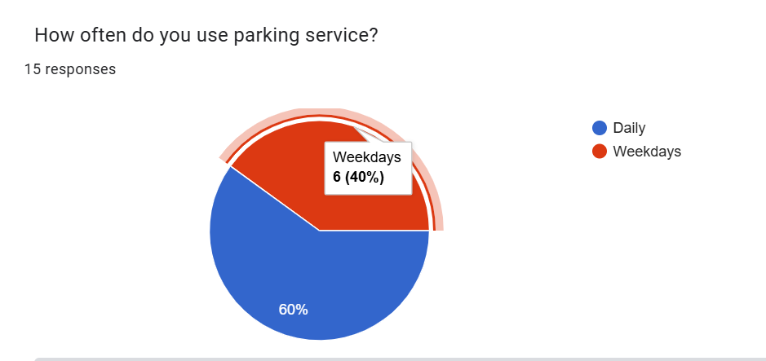
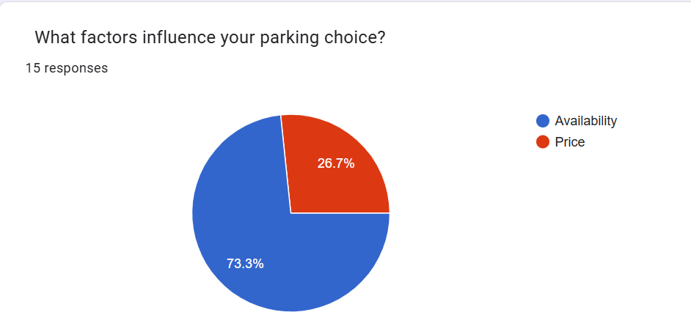
Questionnaire
Questionnaire was carried out using online google forms
Samples of questions and responses

Slide 7
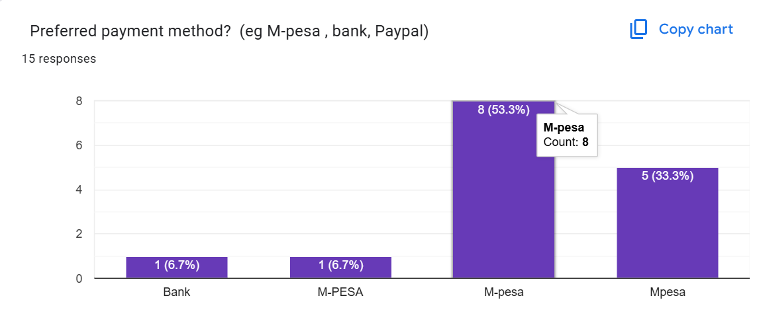
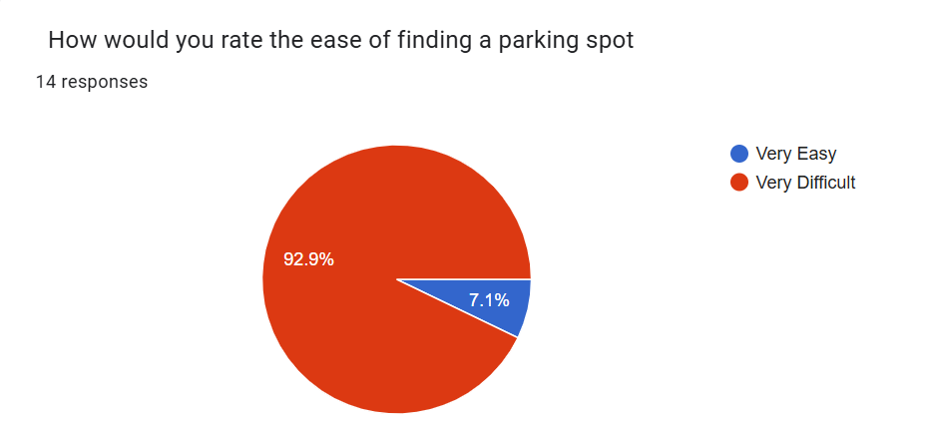

Slide 8
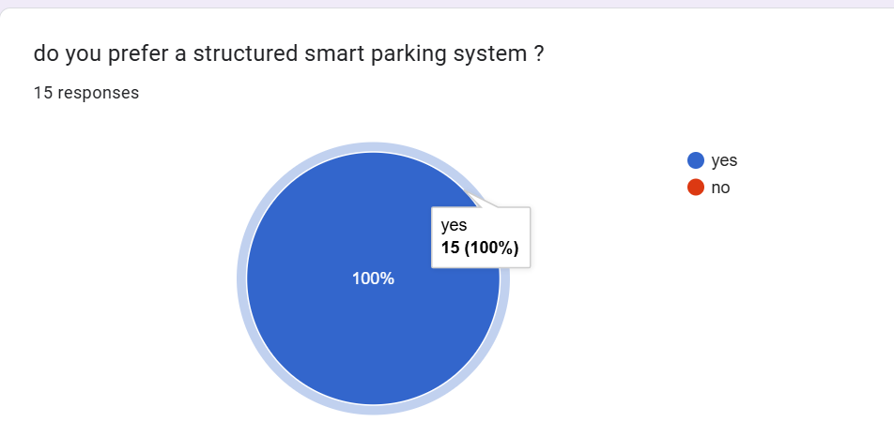

Slide 9
REQUIREMENT SPECIFICATIONS
The system specifications outline the essential functional and non-functional requirements of the smart parking system
Functional requirements
Real-time parking space detection and updates
Parking reservation
Automated payment processing
User notifications and alerts
Predictive analysis for parking demand
Administrative control panel
Non-functional requirements
Performance
Reliability and availability
Scalability
Usability
Security
Data integrity and accuracy

Slide 10
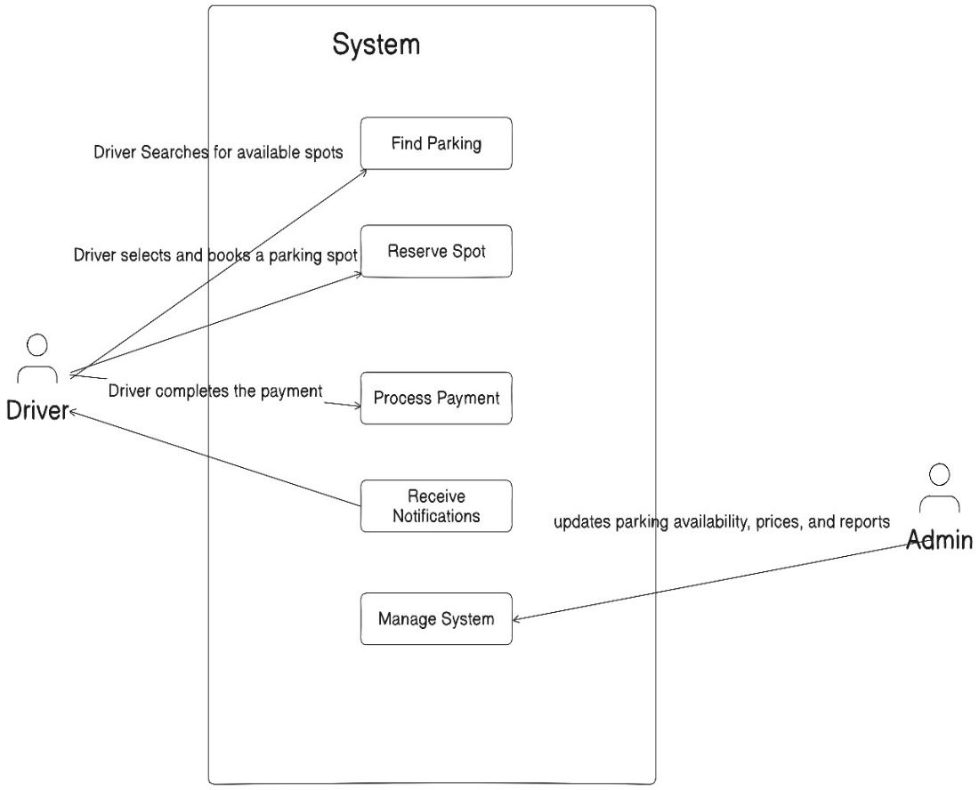
ANALYSIS MODELS
Use case diagram
Actors:
Driver: Find parking, reserve a spot, pay, receive notifications
Admin: Manage parking lot, view analytics, adjust pricing
Use Cases:
Find Parking (Driver searches for available spots)
Reserve Spot (Driver selects and books a parking spot)
Process Payment (Driver completes the payment)
Receive Notification (System sends alerts about parking status)
Manage System (Admin updates parking availability, prices, and reports)

Slide 11
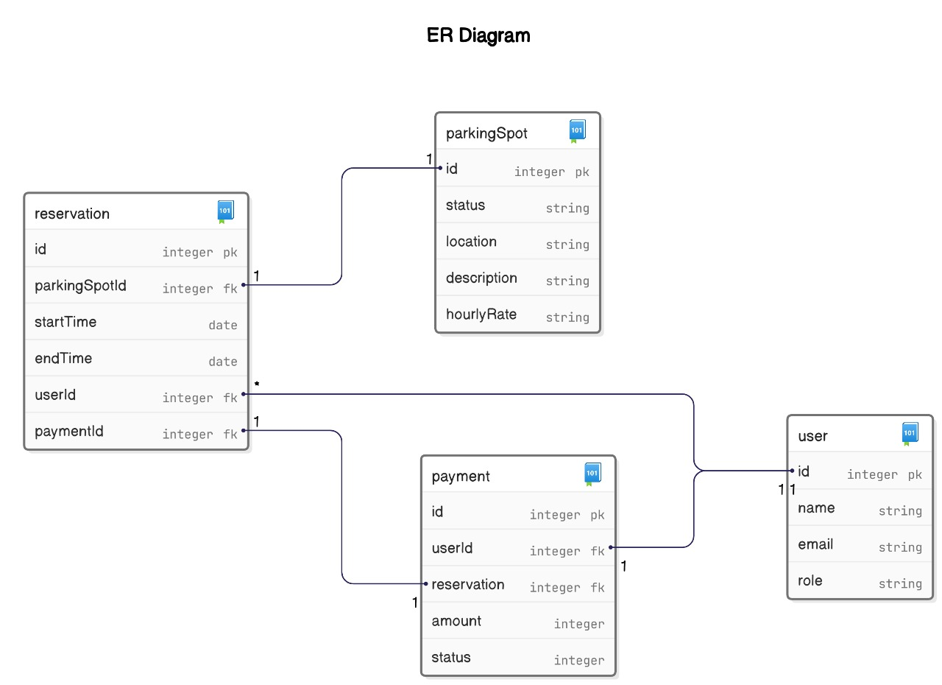
Relationships:
Database considerations
Indexing: Optimize search queries on spotID, userID, and reservationID.
Data Integrity: Use foreign key constraints to maintain relational integrity.
Security: Encrypt sensitive user data and apply access controls.
Scalability: Design schema to accommodate future features (e.g., EV charging spots).
Backup & Recovery: Implement automated backups to prevent data loss.

Slide 12
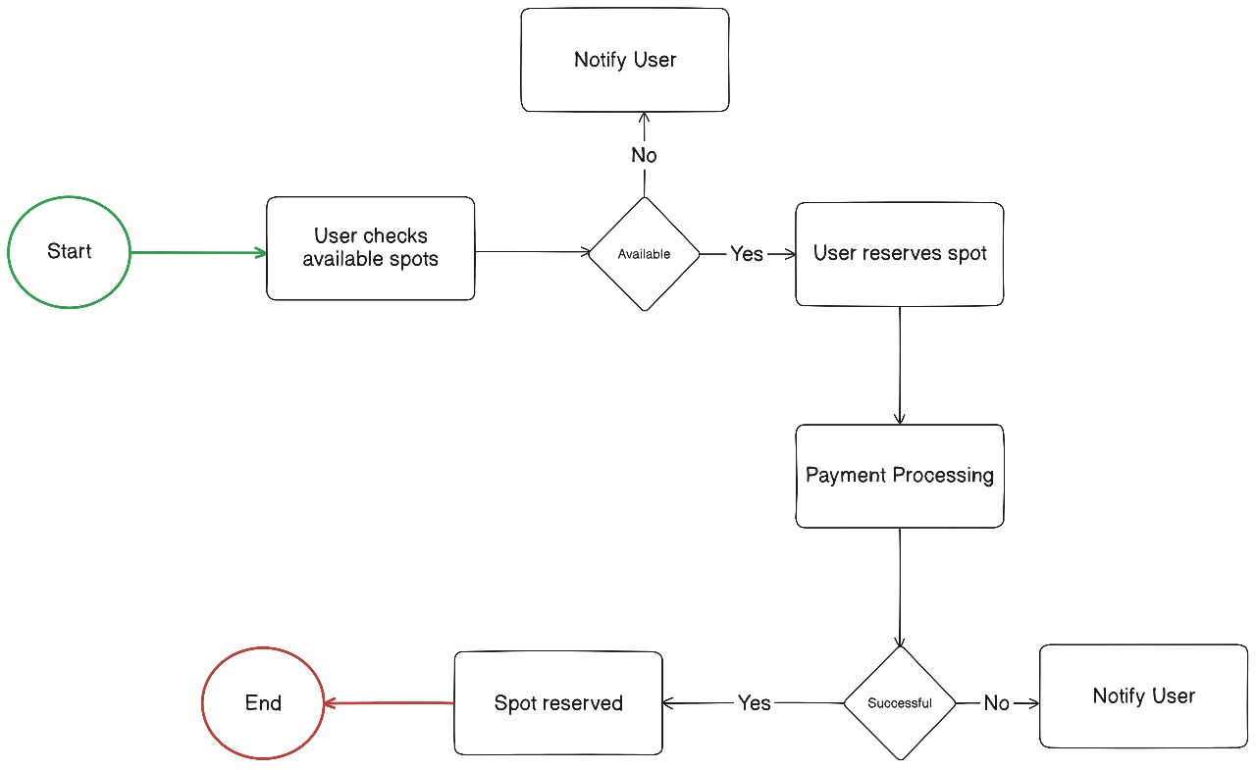
DESIGN
Key areas where the flow chart touches
User checks available spots
User reserves spot
Payment processed
Spot reserved
COMPONENTS
FRONTED- HTML, CSS, React
BACK-END-Javascript

Slide 13

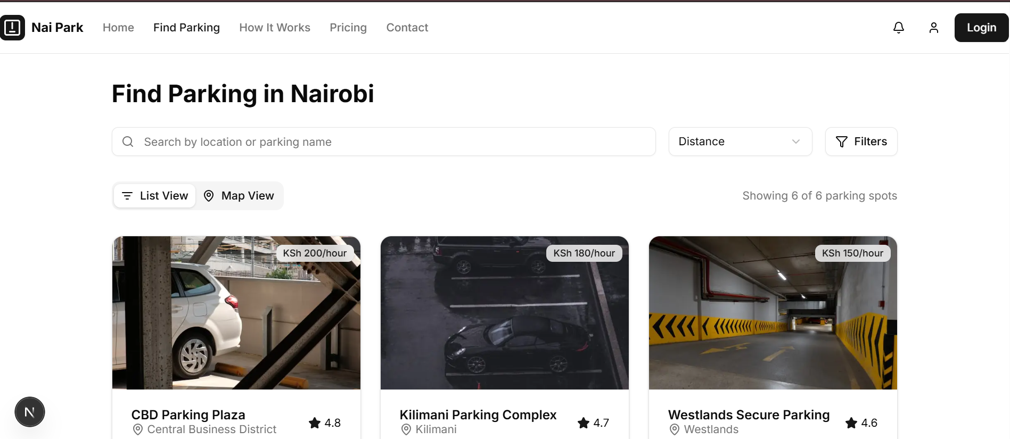
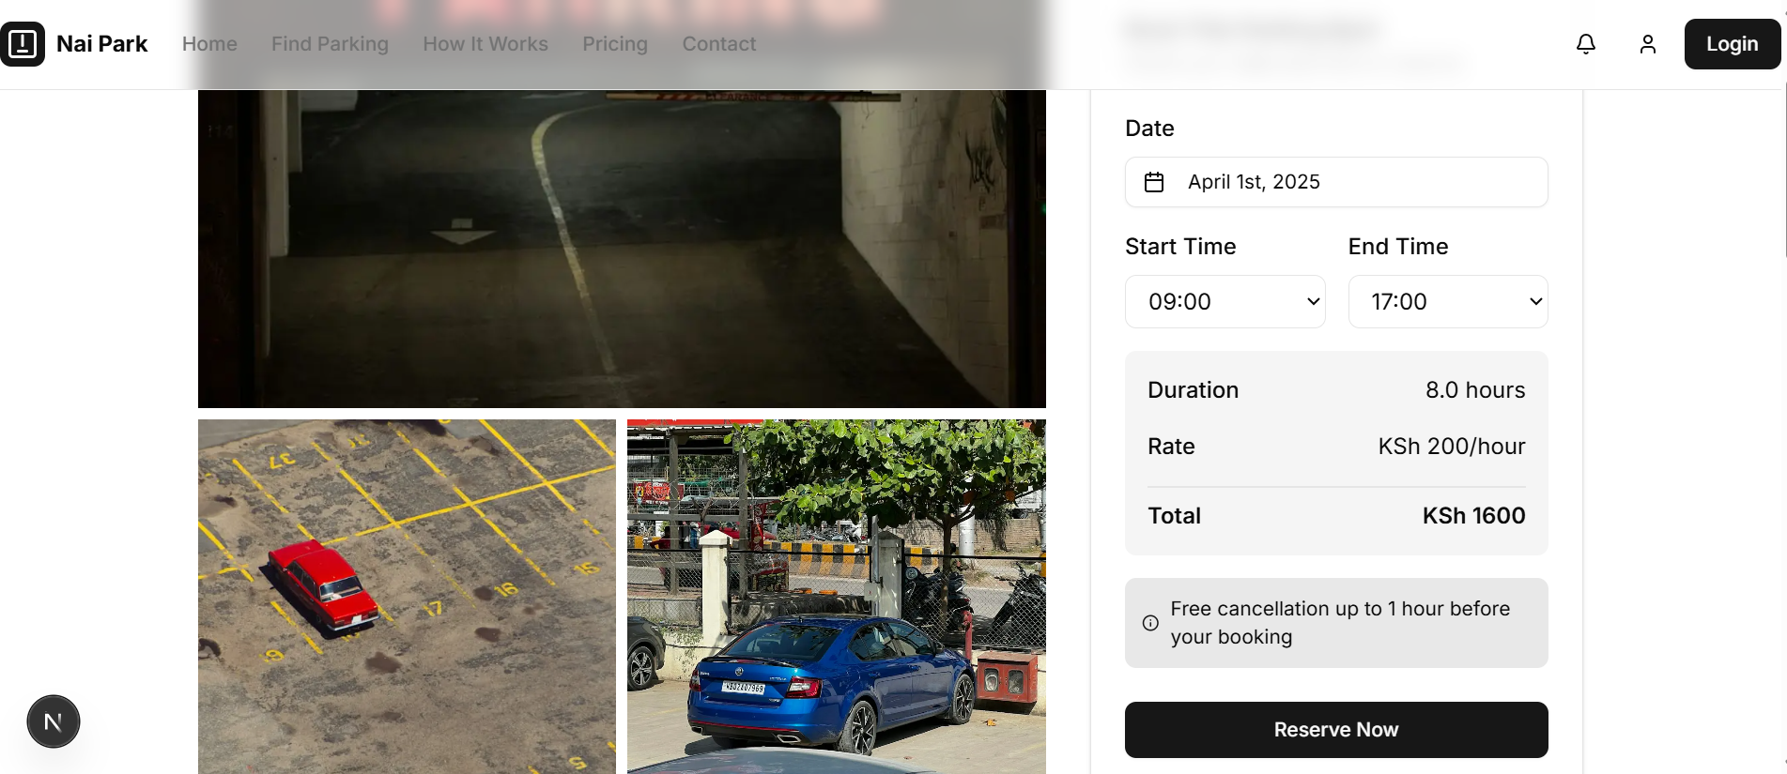
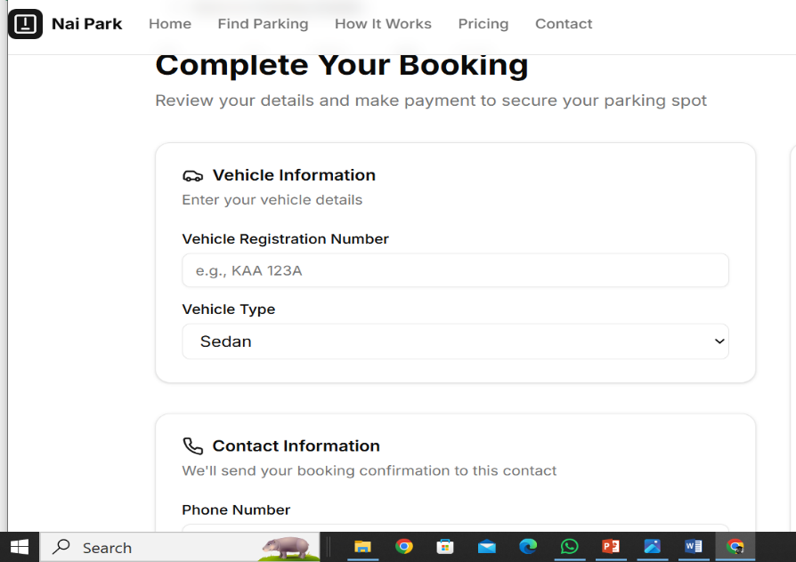
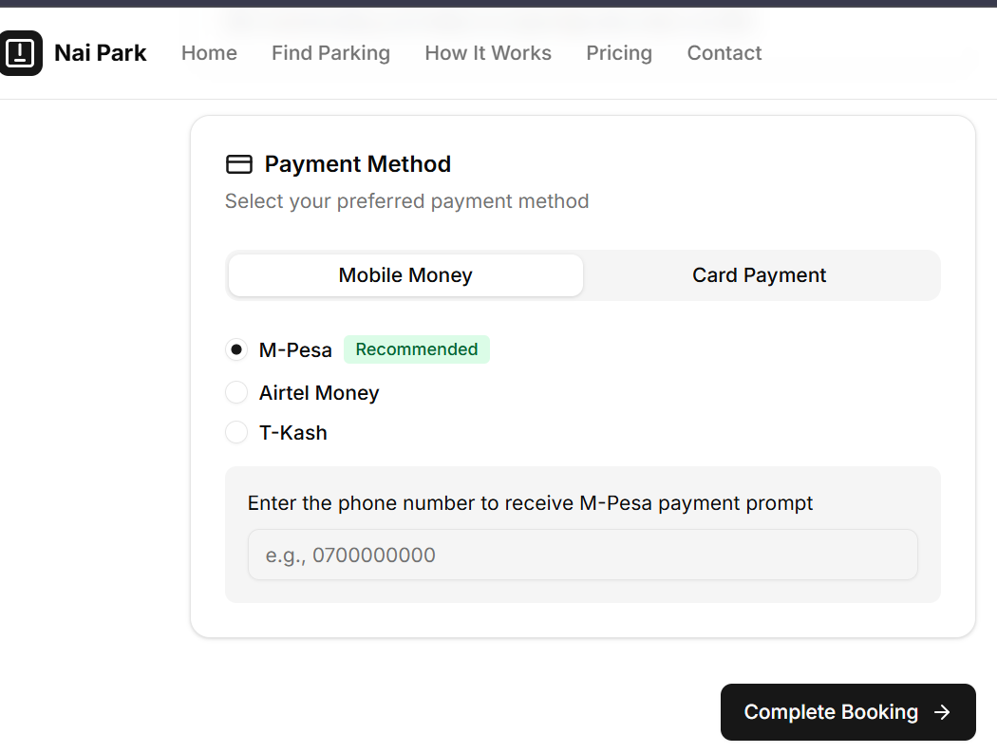
SNIPPET OF MY USER INTERFACE

Slide 14
THANK YOU

